Slide 1

Growing Affordable
Housing in
[Council Area]
[Name /Position]
[Organisation]

Slide 2

Purpose of Presentation
To introduce [CHP] and our capacity to support [Council or other authority] to grow the supply of affordable housing in [where].
Notes:
2

Slide 3
Content of Presentation
What is ‘affordable housing’?
Why does it matter?
What is the need for affordable housing in [area]?
What are some common myths about affordable housing?
Who is [CHP] and how can we help?
[What are we proposing?]
Notes:
3
[This presentation can be used as a generic introduction to affordable housing, housing need, ‘myth busting’ and your organisation. The last slides in the presentation can also be used if you are coming to your Council with an early development proposal (e.g. in a pre-DA meeting) or to request that your council provide land for a partnership development, etc]

Slide 4
What is Affordable Housing?
Housing is ‘affordable’ when…
  Very low-, low- or moderate-income households pay no more than 30% of gross household income on rental or mortgage payments, according to relevant benchmarks.
Notes:
4
The widely used definition of an affordable dwelling is where the rental payments or mortgage repayments consume less than 30% of the gross income of the household living in that dwelling. However, this definition only applies to very low, low and moderate income households, or those households earning up to 50%, between 50% and 80% and between 80% and 120% of the median household income for Greater Sydney respectively.

Slide 5
What is Affordable Housing?
Affordable rental housing can include a wide range of products including:
‘Key worker’ housing at discount market rent
Social housing (rent as a % of income)
Special housing products in some markets:
  Boarding houses
  Secondary dwellings
  Smaller apartments
  Shared ownership or shared equity
Notes:
5
The widely used definition of an affordable dwelling is where the rental payments or mortgage repayments consume less than 30% of the gross income of the household living in that dwelling. However, this definition only applies to very low, low and moderate income households, or those households earning up to 50%, between 50% and 80% and between 80% and 120% of the median household income for Greater Sydney respectively.

Slide 6
When is housing ‘affordable’?
Household Income Band | Gross Weekly Household Income | Maximum Affordable Weekly Rental Payment | Maximum Affordable Purchase Price
Very Low | <$800 | <$240 | <$220,000
Low | $800-$1,274 | $240-$379 | $220,000-$344,999
Moderate | $1,275-$1,899 | $380-$569 | $345,000-$519,999
Higher | $1,900+ | N/A | N/A
Notes:
6
These bands are shown in the table on the slide, and have been adjusted for inflation (2016 dollars). The corresponding affordable rents for each income band are also shown, as are the affordable purchase prices assuming that the purchaser has a 20% deposit and takes out a 30 year loan. Affordable purchase prices were calculated using the Commonwealth Bank Home Loan Repayments Calculator using the current interest rate (as at 25 November 2016) of 5.22%. The median gross weekly household income for Greater Sydney ($1,447) was taken from the ABS Census of Population and Housing 2011.
https://apps.commbank.com.au/digital/propertyhub/calculator/home-loan-repayments
Note:
1. Prices have been adjusted for inflation using ABS Consumer Price Index Data
2. Maximum Affordable Purchase Price is based on 5.22% Standard Variable Rate Home Loan and assuming a 20% deposit.
(Source; JSA 2016, based on data from ABS Census of Population and Housing 2011, Commonwealth Bank Home Loan Repayment Calculator, accessed 25 November 2016)

Slide 7
Why does Affordable Housing matter?
  Reduces economic viability and competitive advantage
  Displaces key workers, many on very low incomes
  Displaces young people, retired renters, families
  Affects social equity and sustainability
  Makes a less diverse and vibrant community!
Notes:
7
There are compelling reasons to invest in affordable housing as key social infrastructure. Although the problem is particularly acute across Sydney, many regional many regional communities are also facing critical community housing problems that are impacting on their social and economic wellbeing.

Slide 8
What is the need for Affordable Housing?
Housing affordability is a critical issue in [area]:
[Rank] out of 152 LGAs in NSW for rental cost for smaller dwellings ($_______)
[Rank] out of 152 LGAs in NSW for rental cost for smaller dwellings ($_______)
Notes:
8
Did you know that your local government area is ranked [insert rank from Table ? in the Toolkit] out of 152 LGAs in NSW for rental on accommodation suited to a smaller (couple or lone person) household (2 bedroom units)? In June 2016, this was $[insert] per week compared with $[insert] for [NSW or Greater Sydney, depending on the Council area].
Did you know that your local government area is ranked [insert rank from Table ? provide in the Toolkit] out of 152 LGAs in NSW for rental on a home suitable to a family (3 bedroom separate houses)? In June 2016, this was $[insert] compared with for [NSW or Greater Sydney depending on Council area].
(Source: Housing NSW Rent and Sales Report, September 2016).

Slide 9
What is the need for Affordable Housing?
Ratio of rental cost: very low and low income renters for [insert] LGA compared with [insert] for [NSW or Greater Sydney]
[insert] LGA ranks [insert] out of 152 LGAs in NSW
Notes:
9
Another important indicator of affordability is the ratio of average rental cost in an LGA over the proportion of very low and low income renters, weighted for absolute number of very low and low income renters to make sure areas with a very small population are not unreasonably prioritised. [Describe the data on the slide, using the tables in the Toolkit complete the slide inserts].
(Housing NSW Rent and Sales Report, September 2016, and ABS 2011 Census CPI adjusted).

Slide 10
What is the need for Affordable Housing?
[INSERT RELEVANT MAP FROM TOOLKIT]
Notes:
10
[Insert relevant map/s from the Toolkit to show where your area is located with respect to need].

Slide 11
What is the need for Affordable Housing?
Number in housing stress in [insert] LGA:
  [Insert no.] very low income renters (% of total)
  [Insert no.] low income renters (% of total)
  [Insert no.] moderate income renters (% of total)
  ____________________________________
  Total renters in housing stress: [Insert no.]
[insert] LGA ranks [insert] in NSW for the number of renters in housing stress
Notes:
11
(Use Table ? provided with the Toolkit to fill in this slide).
A household in said to be in ‘housing stress’ when it is paying more than 30% of gross household income on rental or mortgage costs. In [insert] LGA there were [total number] of renting household in housing stress at the time of the 2011 Census. The greatest need in the LGA is among [insert] renters [calculate the % out of 100%, e.g. if 80 out 100 are very low income households, this is 80% of the total number of renters in housing stress], as shown in the slide. The LGA is ranked [insert] out of 152 LGAs in NSW in terms of the total number of very low, low and moderate income private renters in housing stress.

Slide 12
What is the need for Affordable Housing?
[INSERT RELEVANT MAP FROM TOOLKIT]
Notes:
12
[Insert relevant map/s from the Toolkit to show where your area is located with respect to need].

Slide 13
What is the need for Affordable Housing?
Proportion of target group in housing stress:
[?]% of very low income renting households
[?]% of low income renting households
[?]% of moderate income renting households
On combined housing stress indicators, [insert] LGA ranks [insert] out of 152 LGAs in NSW on this measure of housing need.
Notes:
13
[Use Table ? provided with the Toolkit to fill in this slide].
Housing stress is a major issue among the key target groups for affordable housing in [insert area]. [Describe the data on the slide with regard to the % each target groups in housing stress]. The Federation of Community Housing Toolkit has developed a ranking index of comparative housing stress across NSW LGAs by combining a number of measures, that is, the total number of renters in housing stress, % of the target group in housing (rental) stress, and % of all households in housing (rental) stress. On this index, [insert] LGA ranked [insert] out of 152 LGAs in NSW at the time of the 2011 Census.

Slide 14
What about housing diversity?
Ratio of smaller households to smaller dwellings was [insert ratio] compared with [insert comparator ratio as ?:?]
[Insert] LGA ranks [insert] out of 152 LGAs in NSW in on the need for more smaller housing.
Notes:
14
The need for greater housing diversity is also an issue in [insert] LGA. [Describe the data on the slide, using the tables in the Toolkit complete the slide inserts]. As well as affordability, providing for greater housing diversity will be a challenge in [insert] LGA in the future.

Slide 15
What else do we know about local affordability?
[Insert qualitative and quantitative information from your own agency or community, for example:
Waiting list data – total and household type
Information from homelessness services
Information on the state of the local housing market (e.g. related to private rental availability, vacancy rate, difficulty head leasing, etc)]
Notes:
15
Insert other relevant information from data that you have, your own waiting list, or your experiences or research in the local housing market.

Slide 16
What are some common myths?
Affordable housing residents are ‘different’ to other people in the community!
Affordable housing is sub-standard accommodation!
You can ‘tell’ which is the ‘affordable housing in a development!
Including affordable housing will reduce property values!
Notes:
16
There are a number of common myths about ‘affordable housing’. Although may often hear these, the evidence does not generally support these myths. Let’s have a look at some of the most common.

Slide 17
Who lives in Affordable Housing?
Examples of very low income households:
Couple with one caring for young children and one F/T nursing assistant on $760 p/w
Couple P/T retail and hospitality on $740 p/w
F/T aged care worker or cleaner on $720 p/w
Aged pensioner couple on $654 p/w
Aged lone female pensioner on $434 p/w
Middle aged woman on Newstart on $262 p/w
Notes:
17
Households on very low incomes (one of the main target groups for community housing) come from diverse backgrounds, ages, types of families and employment profiles. They are people who already live in your community, or who would have lived there if they were not priced out of the local housing market. This includes a family where one person is working as a full-time aged care worker or cleaner who earns on average $720 per week, where their partner cares for their young children, to an aged pensioner couple on $654 per week, or a middle aged man on $262 per week. These families can only pay a maximum of $240 per week rent. The lone person on NewStart can only afford to pay $79 per week. Either way, there are very few areas in NSW where such rents are available, and almost nowhere in Greater Sydney.

Slide 18
Who lives in Affordable Housing?
Story of a ‘very low income’ household in Greater Sydney with AH
Trang is 28 years old. She arrived from Vietnam five years ago to marry an Australian man she had met on the internet.
Trang felt lucky to get a full-time job as a cleaner at the Royal Prince Alfred hospital in Camperdown. She made an award wage of $750 per week.
The relationship spectacularly broke down just two years after she arrived and they were married. She packed her things and moved out of their place. She has been living between two friends’ places for the last two years while she has been trying to find her own place that she can afford. It seemed that her luck had well and truly run out.
A colleague at the hospital suggested that she contact the local Community Housing Provider. Trang made the call and in just a few months, she was moving into a studio apartment right near the hospital. It was small, but it was hers. Best of all, her rent was affordable on her cleaner’s wage. It gave her the freedom to save a little bit and think about what she wanted to do with her life next.
Notes:
18
[These are some case studies from the Toolkit – or you can use your own case studies that may be more relevant to your area or target groups].

Slide 19
Who lives in Affordable Housing?
Story of a ‘low income household’ in Greater Sydney with AH
Luli is a 25 year old Chinese national and Australian permanent resident. She has a Diploma of Early Childhood Education and Care and works at an inner Sydney City child care centre for the last year earning just above award wage rate at $890.00 per week. She has been living with five friends in a three-bedroom flat in the CBD. The owner of the unit has decided to sell. Luli wanted to stay in the City, close to where she worked, if possible. She did not own a car and weekly transport costs would eat into money saved on rent. Living with five other people was also becoming difficult. Luli searched for a studio or one-bedroom apartment in the CBD. Very few properties came up that she could afford. Luli saw an ad for an Affordable Housing property in Ultimo, managed by SGCH. Luli met the income and residency requirements and decided to lodge an application. SGCH approved her application and offered her a new, studio apartment that she can afford that is also close enough to walk to work.
Notes:
19
[These are some case studies from the Toolkit – or you can use your own case studies that may be more relevant to your area or target groups].

Slide 20
Who lives in Affordable Housing?
Story of a ‘low income household’ in a regional area with AH
Mal is 75 years old. He has been on his own since his wife Hazel died last year. Mal and Hazel rented the same old, two-bedroom flat in Tweed Heads for the last 12 years. They lived frugally and were always able to make their rent, which was now around $285 per week. Since Hazel died, Mal’s aged pension reduced and he was unable to make his rent and his other expenses. He missed Hazel and was so sad to say goodbye to the home that they shared together. He didn’t even know where to start to find a new place. He felt bewildered and worried. He saw a pamphlet for the local Community Housing Provider at the library. He gave them a call and before too long he was packing his things and moving into a new, one-bedroom flat not far from where he was living with Hazel at a rent he could afford on his pension. While he still misses the old place, he is not worried about his future anymore. He enjoy sitting out on his balcony and is getting to know his new neighbours.

Slide 21
Who lives in Affordable Housing?
Story of a ‘moderate income household’ in Greater Sydney with AH
Ravi and Shanti are both 40 years old. They came to Australia from India in their early twenties and recently became Australian citizens. They have three children, aged 16, 13 and 10.
Ravi and Shanti both work full-time at the restaurant they run with Ravi’s brother in Parramatta. They earn $1700 per week. They were renting a three-bedroom unit in Ashfield for $675 per week, but things were becoming unmanageable with all of their other expenses.
They were successful in their application for an Affordable Housing property in Ropes Crossing managed by Wentworth Community Housing. They are thrilled with the new, four bedroom house with a yard with a rent they can afford at $535 per week. Getting to the restaurant isn’t too bad and they are willing to do it, so they can save more for their children’s education.

Slide 22
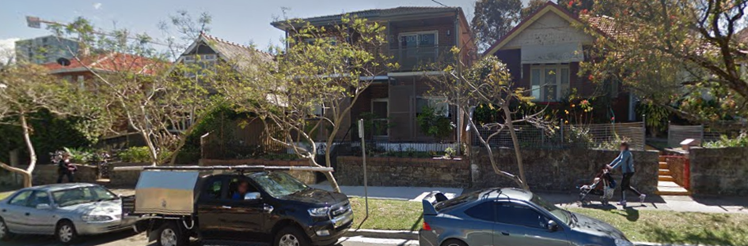
What does Affordable Housing look like?
A well-designed boarding house that fits in with the streetscape of a very unaffordable inner city suburb.
Notes:
22
[These are some case studies from the Toolkit – or you can use your own case studies that may be more relevant to your area, target groups or developments].

Slide 23
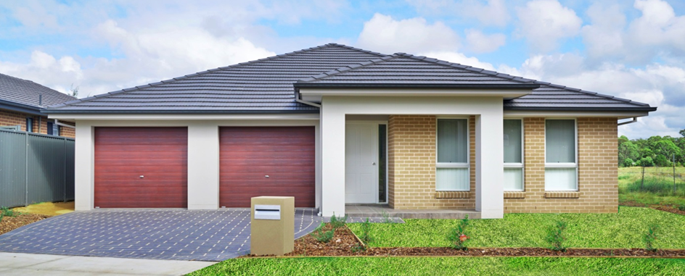
What does Affordable Housing look like?
Family housing, designed to the same high standards as its neighbours, in a new estate in Sydney’s west.
Notes:
23
[These are some case studies from the Toolkit – or you can use your own case studies that may be more relevant to your area, target groups or developments].

Slide 24
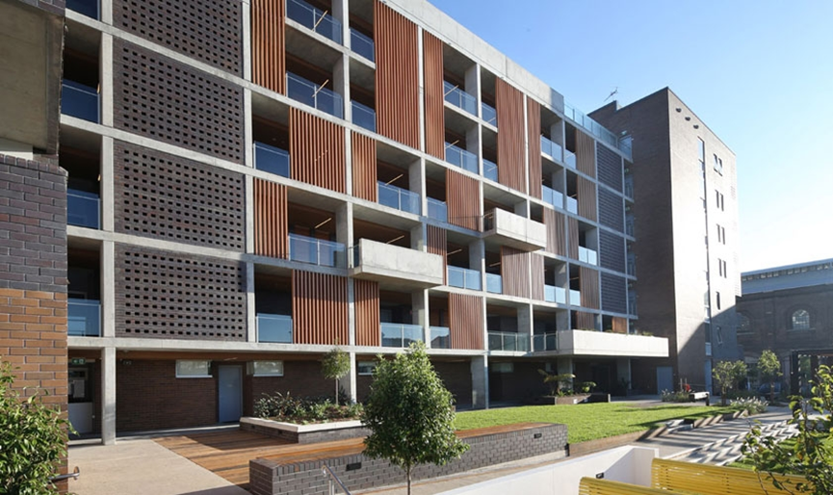
What does Affordable Housing look like?
Award-winning designed multi-storey apartments close to all the transport, service and education opportunities of inner Sydney.
Notes:
24
[These are some case studies from the Toolkit – or you can use your own case studies that may be more relevant to your area, target groups or developments].

Slide 25
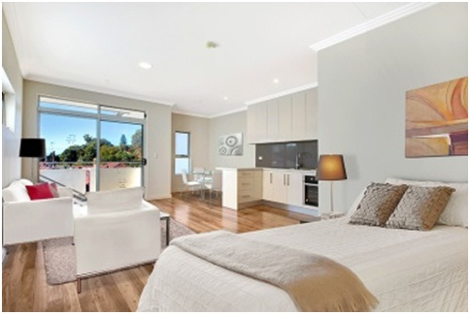
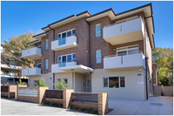
What does Affordable Housing look like?
A well-designed ‘New Generation’ boarding house managed by Hume Community Housing that is compatible with character of the local area.
Notes:
25

Slide 26
Will there be an impact on property values?
There is no evidence that including affordable housing will reduce property values
There is good evidence of increasing property values when affordable housing is included in redevelopment sites:
  Good design
  Urban integration
  Public domain improvements
  High quality management and maintenance
Notes:
26
There is no evidence that including affordable housing in a development or within a precinct will reduce property values, and good evidence of increasing property values when affordable housing is included in redevelopment sites. Factors that are more important in relevant research include good quality design of dwellings, including tenure blindness in mixed tenure developments (making sure that you can’t tell the difference from the outside of a building which is the private and which the affordable housing, and making sure they are of the same high standard of finish and have equal access to open space and public domain); making sure that the new development ‘knits with’ the surrounding urban area, and that attention is paid to providing high quality shared open space and public domain improvements; and that there is timely maintenance the exterior of building and public areas, and proactive management.

Slide 27
Will there be an impact on property values?
Studies generally find no significant impact, or an improvement in value
For example, Davison, et al (2013):
  Across the 17 projects in Sydney and Brisbane, inclusion of AH had no significant negative impacts on local property prices.
  Differentials in prices related to:
    Physical amenity /quality of environment
    Proximity to public transport
Notes:
Davison, et al. 2013. Understanding and addressing community opposition to affordable housing development, AHURI (https://www.ahuri.edu.au/research/final-reports/211).

Slide 28
What do the neighbours think?
Only one-third of refusals of SEPP ARH appealed in the LEC had resident objectors
The LEC has never found against a SEPP ARH development based on subjective views of neighbours (JSA 2017).
Notes:
Interestingly, just over one-third of developments under SEPP Affordable Rental Housing 2009 had received resident objections in a recent study for the Federation of Community Housing Associations, and most of these related to physical amenity (parking, privacy, acoustics, etc) or to physical character (e.g. the character test for boarding houses, bulk and scale, compatibility, etc.
A few of these had objections related to ‘who was going to live’ in the development, but such fears were not found to provide reasonable planning grounds for such refusals (see JSA. 2017. Name of Report, Federation of Housing Associations). [See links to Land and Environment Court cases in the Toolkit].

Slide 29
What do the neighbours think?
Perception can be far worse than reality:
  In case studies with greatest community resistance, around 80% had no problems post-occupancy, and most problems related parking and other local issues (Davison et al 2013).
Notes:
Davison, et al. 2013. Understanding and addressing community opposition to affordable housing development, AHURI (https://www.ahuri.edu.au/research/final-reports/211).

Slide 30
About [your agency]
[Insert info about your agency, for example:
History and growth
Mission/philosophy
Types of services provided (including pictures of tenants, current developments, etc)]
Notes:
30
[This can be used to promote your CHP to your council or other authority, and particularly to emphasise your long-term commitment to the community, and what you can offer in terms of capacity to enter into development partnerships, debt financing, etc]

Slide 31
About [your agency]…
[Insert info about your agency, for example:
Long-term commitment to local community
Value adding activities
Partnering capacity and advantages
Priorities and plans for the future]
Notes:
31
[This can be used to promote your CHP to your council or other authority, and particularly to emphasise your long-term commitment to the community, and what you can offer in terms of capacity to enter into development partnerships, debt financing, etc]

Slide 32
About [your proposal]
[Insert info about your proposal or future plans:
Pre-DA information about proposed development, and/or
Potential to partner on Council or State Government land]
Notes:
32
[This can be used to provide an overview if you are coming to your Council with an early development proposal (e.g. in a pre-DA meeting) or to request that your council provide land for a partnership development, etc]

Slide 33
How can we address community concerns?
  We are keen to ‘get it right’:
    Physical amenity (parking, overlooking, solar access, noise)?
    Physical character (local character test, bulk & scale, etc)?
    Administrative issues (compliance, documentation)?
    Understanding community concerns?
Notes:
We know that there may be concerns raised by the community about our development, and we are keen to make sure that we have addressed the most likely issues before we lodge a development application. We’d be very happy to receive any feedback that you have now about the main issues, or to have further meetings with council officers and elected representative to make sure we get it right.
We’re also keen to make sure that we understand and address the main community concerns so that we can build in suggestions into the final proposal. What do you think the best way of consulting with local residents on the proposal would be?

Slide 34
Questions?
Notes:
34
Are there any questions or anything else you’d like to talk about?

